Slide 1
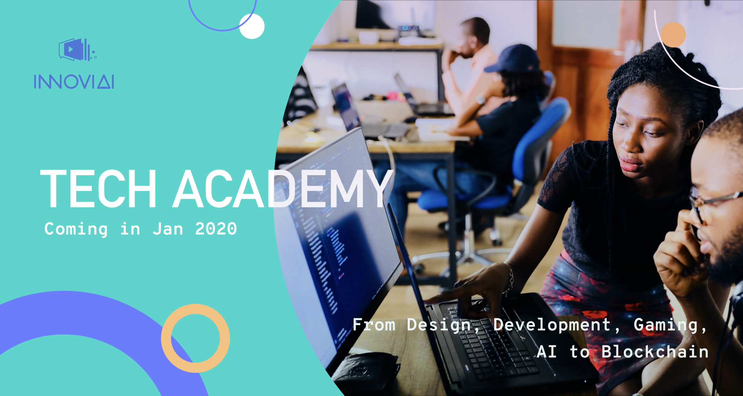

Slide 2

About Me
Founder and CTO of InnoVi Limited which using the latest technologies to conduct digital transformation.
CTO of Necessiti
15+ Years’ programming experience
AI Tech Speaker
AI Mentor in City University of Hong Kong and Whub Hackathon
Conducting the business model, value proposition, uniquencess, NLP technical issues on business intelligence, generate reports
7+ Years of lecturing experience in the IVE and the University of the West of England
Software Development, Game Development and Deep Learning
Programming expert in Java, J2EE, JSP, Servlet, Restful Web Services, 3D Studio Max, Unity, and Tensorflow
Area : Software Development, Game Development, Data Science
Development experience on computer vision, machine learning/deep learning
Unity Certified Developer
Mr Eddie Chow
https://eddiecityu.github.io/

Slide 3
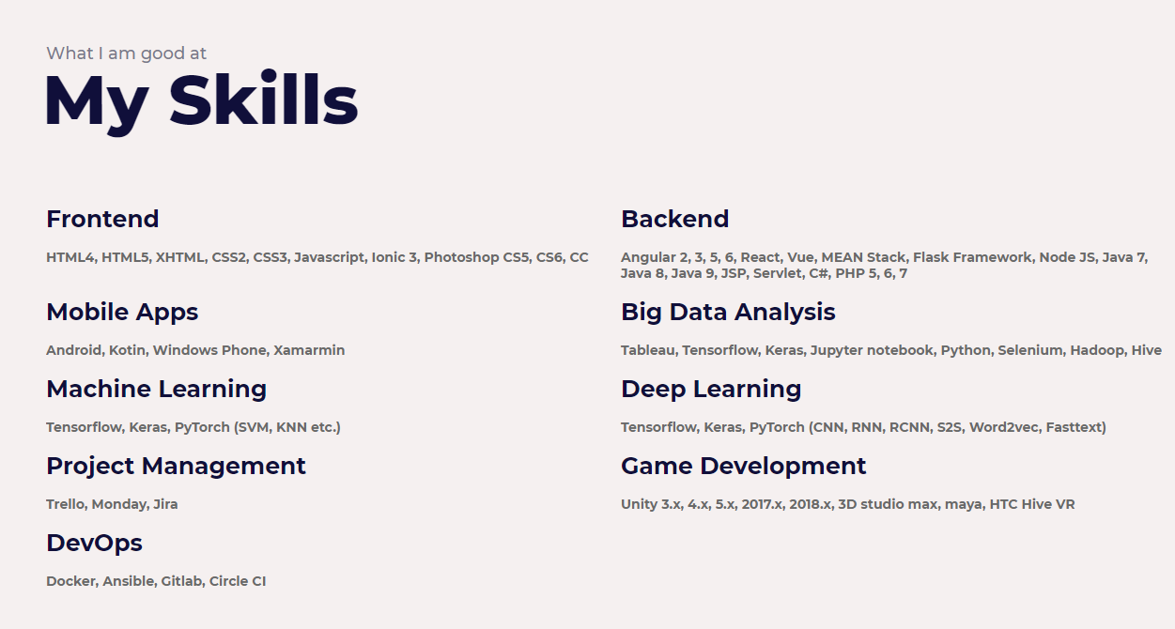
About Me
Mr Eddie Chow
https://eddiecityu.github.io/
https://github.com/eddiecityu
https://www.linkedin.com/in/eddie-chow-a3860464/

Slide 4
AI Showcases
Smart Retail Solution
Warehouse Management System
Indoor Analysis
Facial Recognition Function
Object Detection
Data Visualization

Slide 5
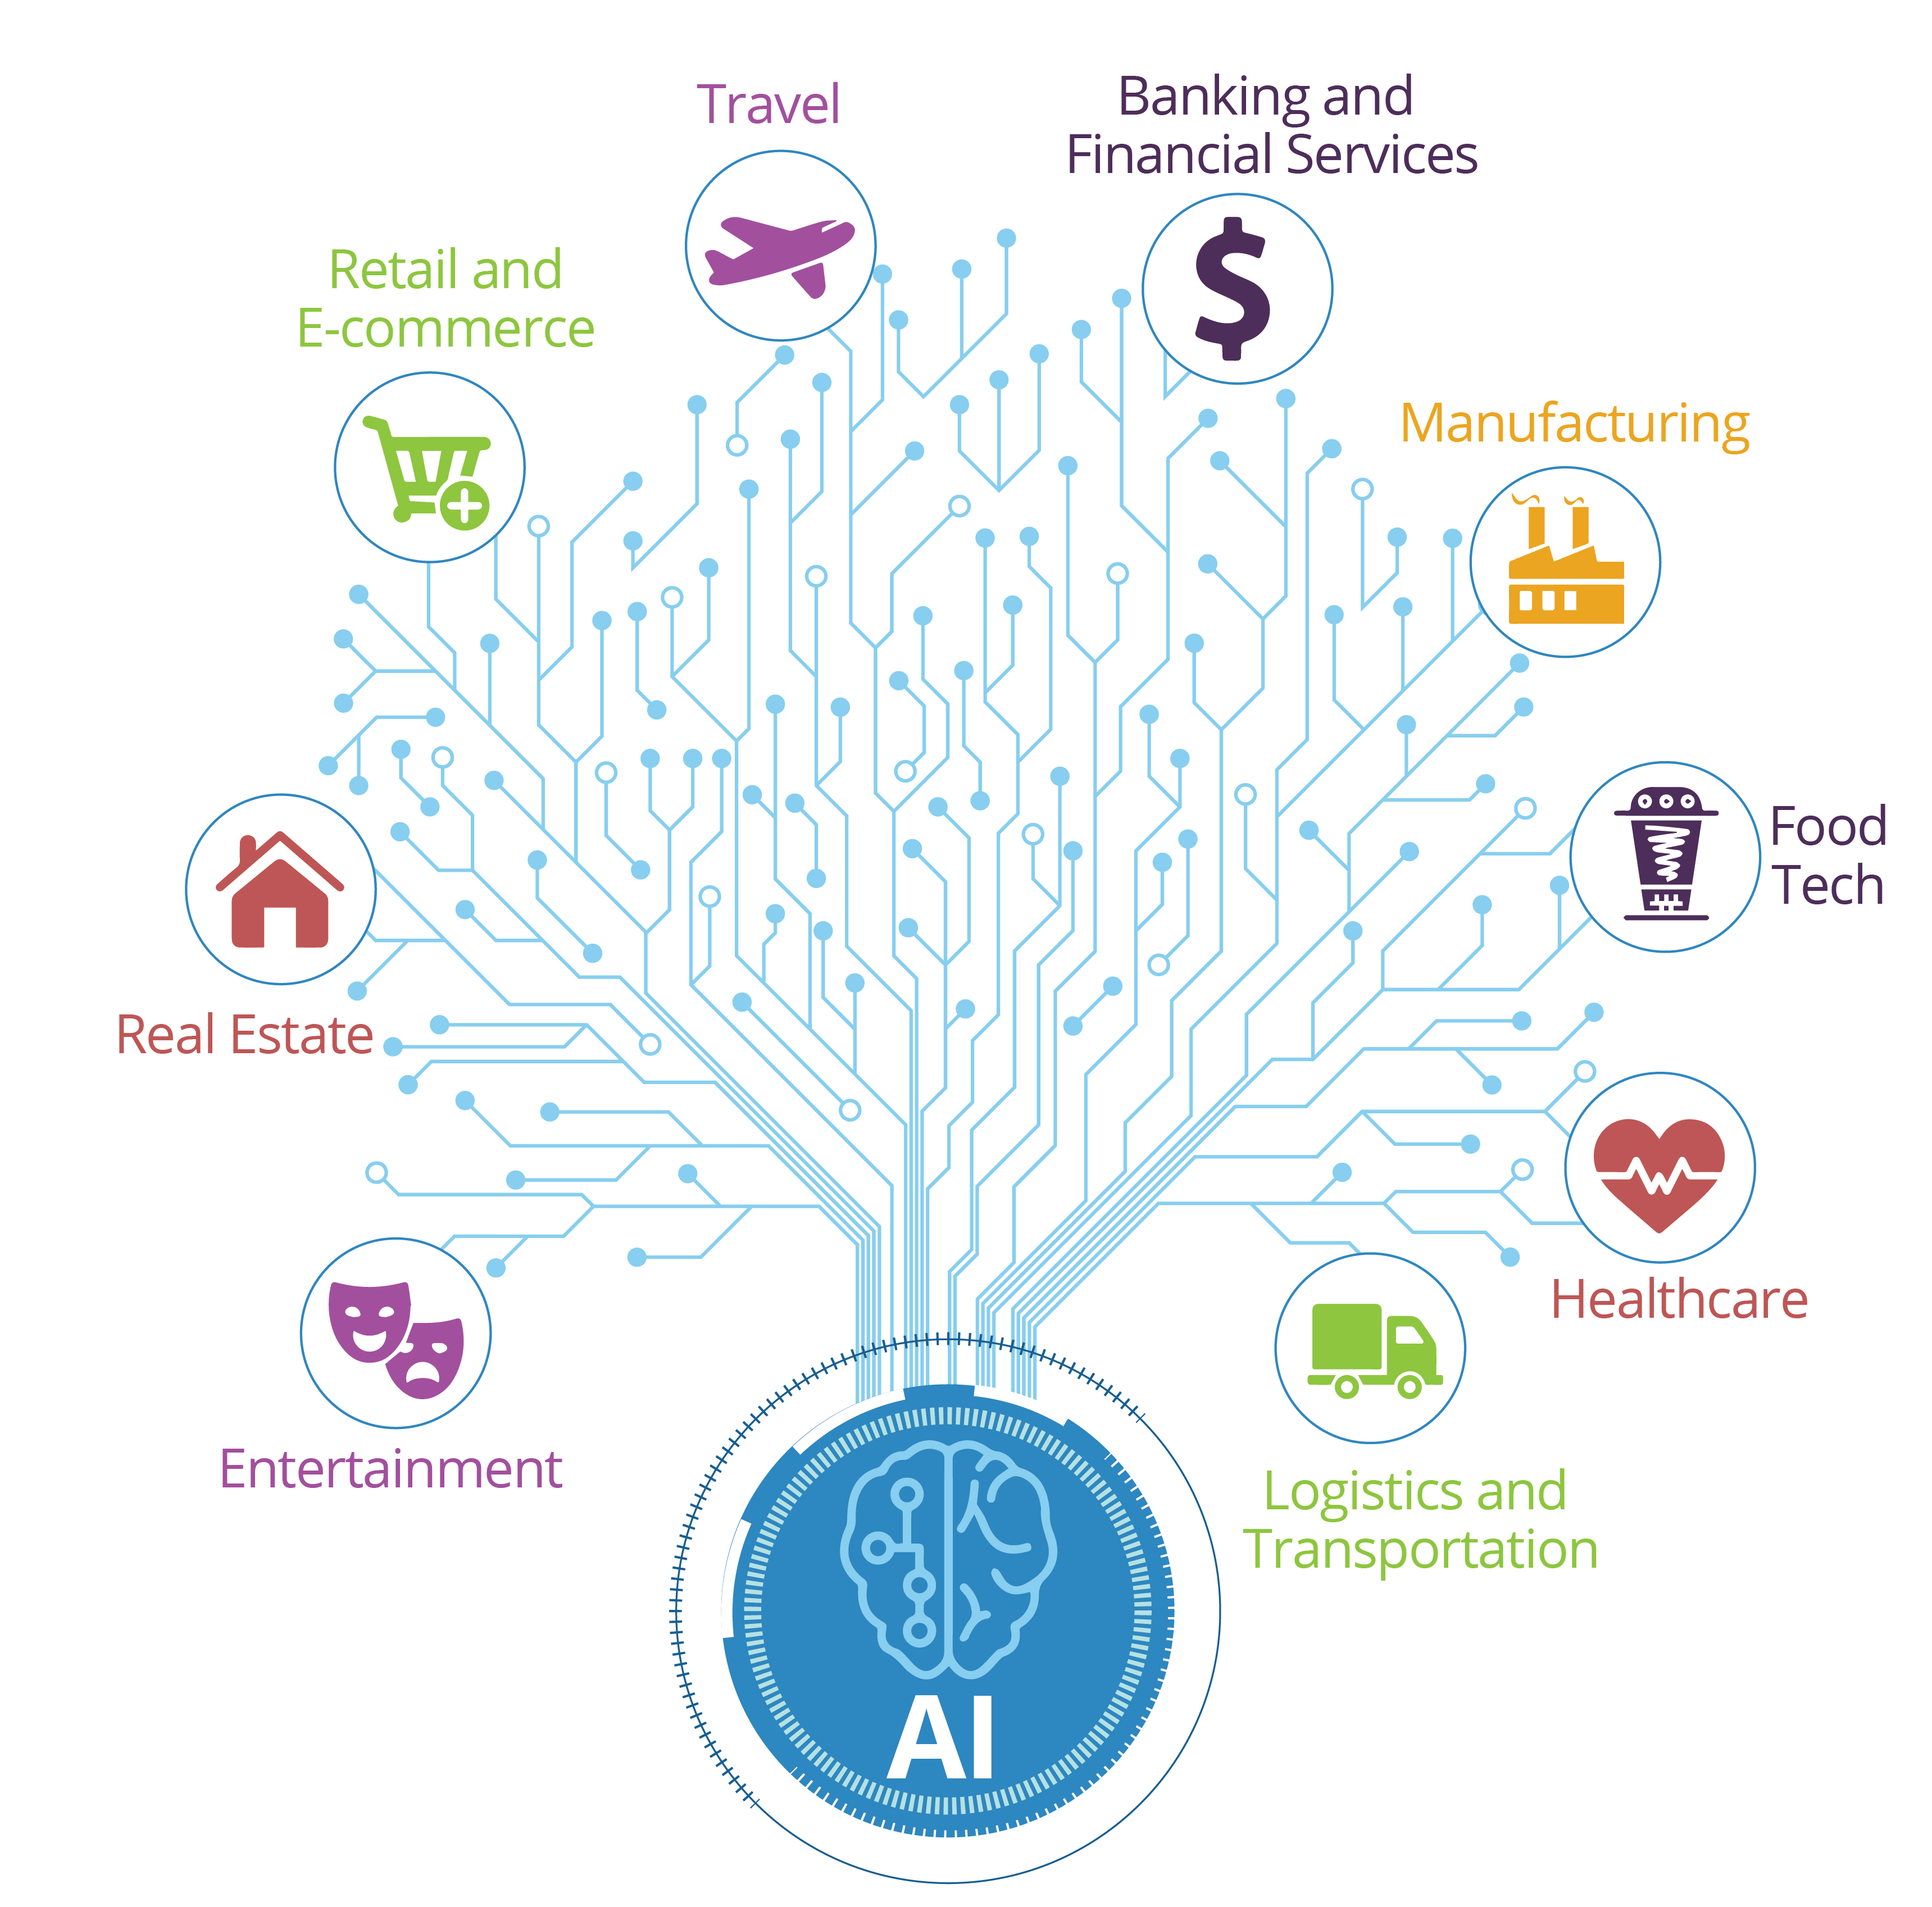
Artificial Intelligence Industrial Areas

Slide 6
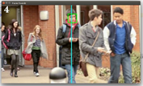
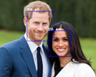
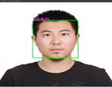
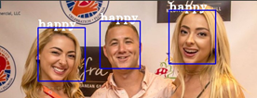
Facial Recognition
People Counting
Detect Age Group
Detect Gender
Detect Emotion

Slide 7
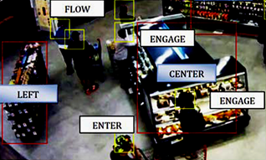
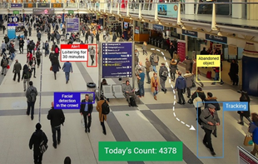
Object Detection
•Identify which set of people like which see different item in the shop
•Identify which item do the customer mostly like

Slide 8
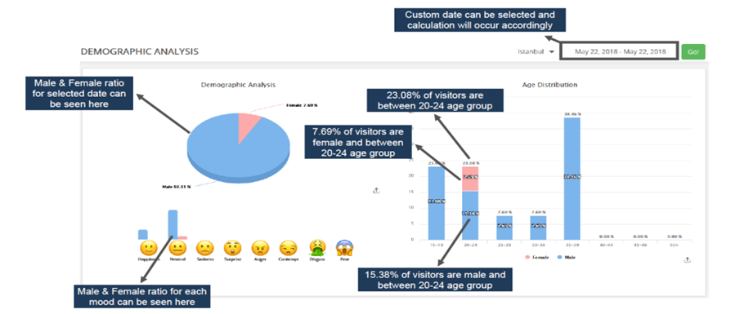
Data Visualization - Demographic Analytic (Age Group, Gender, Emotion)

Slide 9
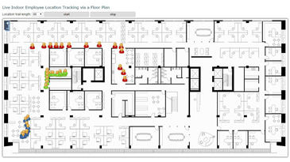
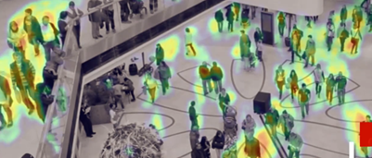
Location Tracking
Customer locations can now be displayed on an shop floor plan in real time.
Digital wayfinding with turn-by-turn navigation for your app, interactive kiosks and website.
Conduct Data Analysis on how your customers are using your space.

Slide 10
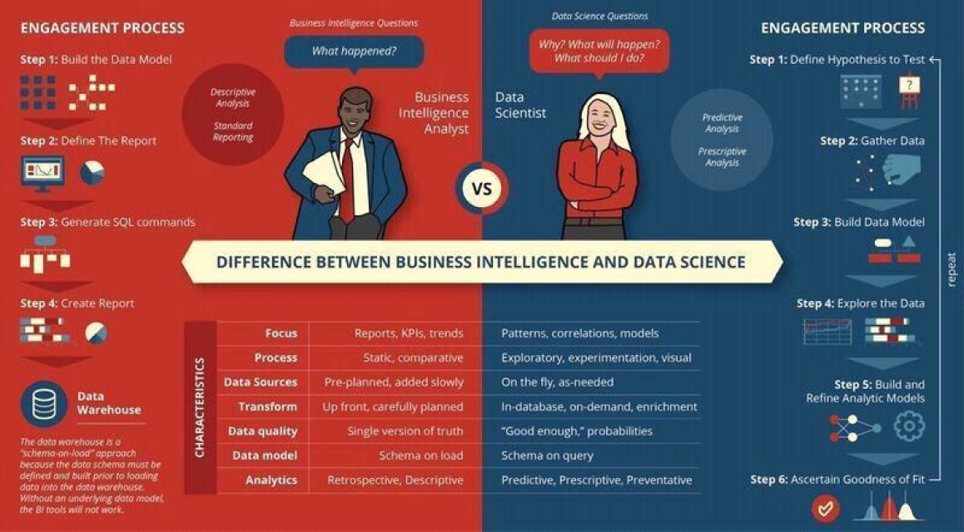
What is the difference between BI and Data Science

Slide 11
AI Market Trend
A Gartner study notes that “by 2020, 85% of customer interactions will be managed without a human” and that by 2040, “more than 40% of all data analytics projects will relate to an aspect of customer experience.”
https://www.forbes.com/sites/forbesagencycouncil/2018/07/16/use-ai-to-create-a-more-personalized-profitable-customer-experience/#59bfc1bd5f3a

Slide 12
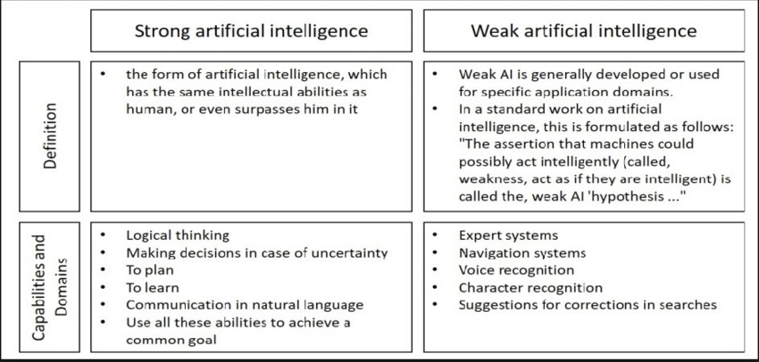
Types of Artificial Intelligence(AI)

Slide 13
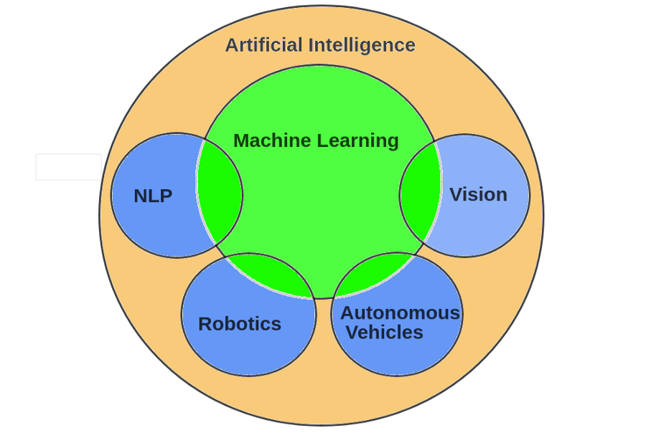
Ways of Artificial intelligence(AI)
Machine Learning (ML)
Deep Learning (DL)
Natural Language Processing (NLP)
Vision
Robotics
Autonomous Vehicles

Slide 14
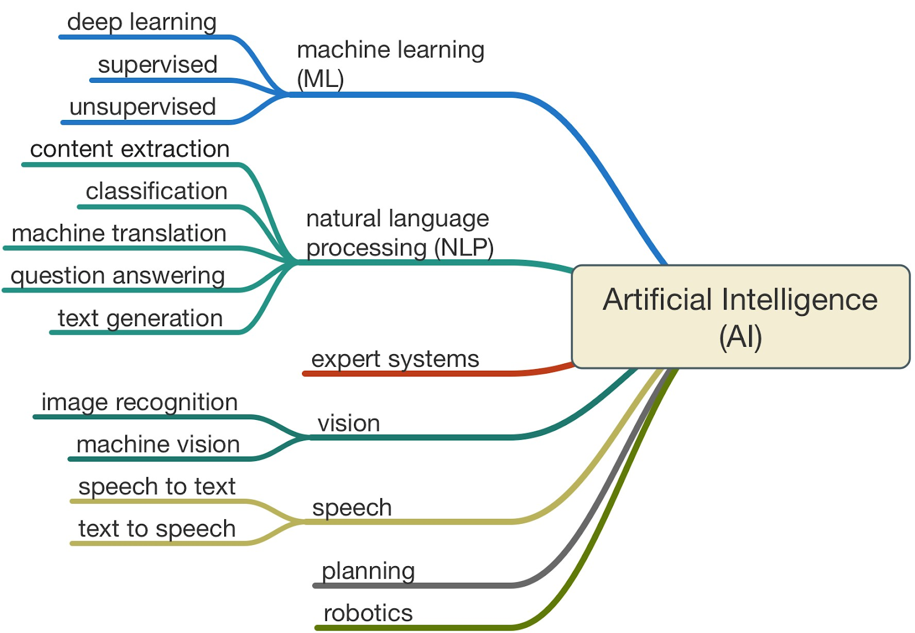
Ways of Artificial intelligence(AI)

Slide 15
Programming
Algorithm
Answers
Data

Slide 16
Programming
Answers
Algorithm
Data

Slide 17
Machine Learning
Answers
Model
Data

Slide 18
Machine Learning
Answers
Model
Data

Slide 19
Machine Learning
Answers
Data
Model
Predictions
Data

Slide 20
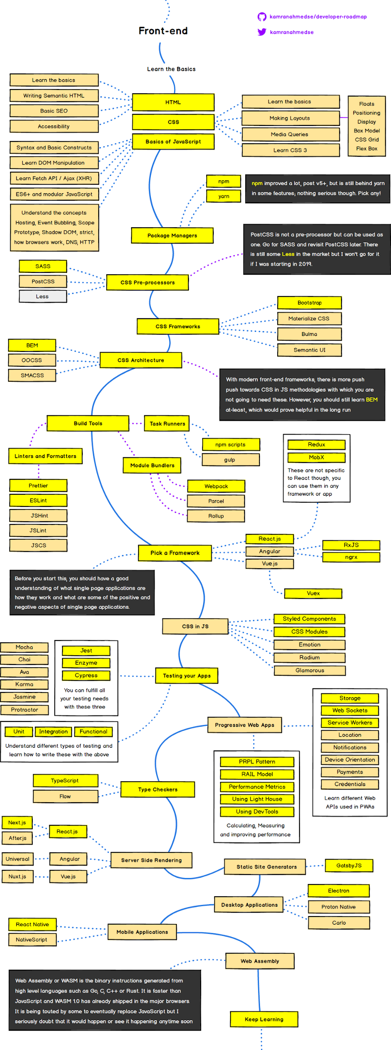
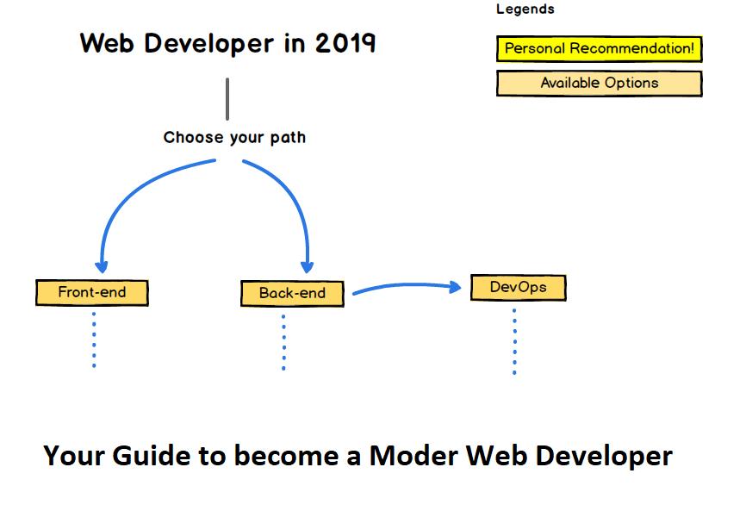
Introduction of Full-Stack Development
https://dev.to/blog/how-to-become-a-full-stack-developer-in-2019-roadmap-2e7h
https://hackernoon.com/the-2019-web-developer-roadmap-ab89ac3c380e

Slide 21
Full Stack Development
https://codingthesmartway.com/the-2020-roadmap-to-fullstack-web-development/

Slide 22
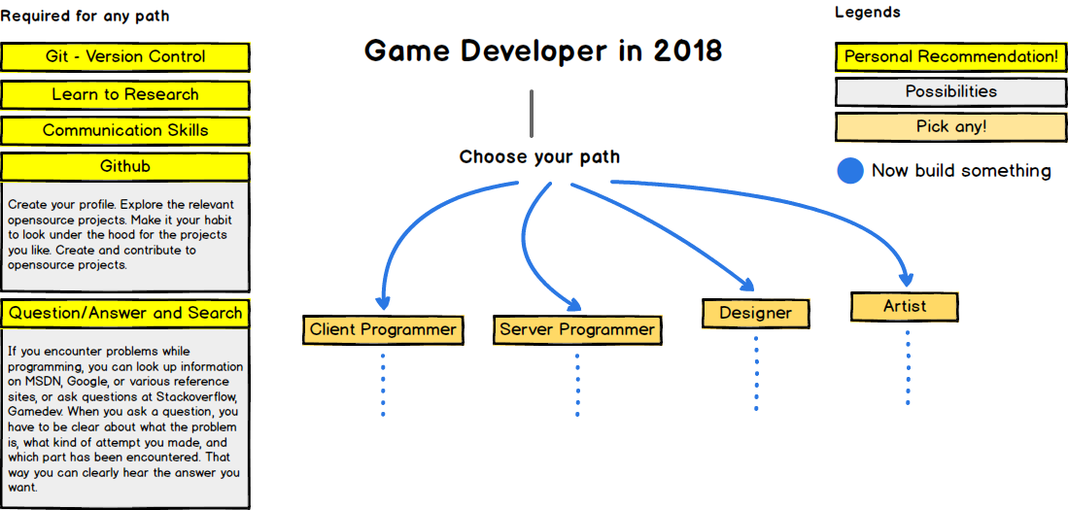
Game Development RoadMap
three.js vs babylon.js

Slide 23
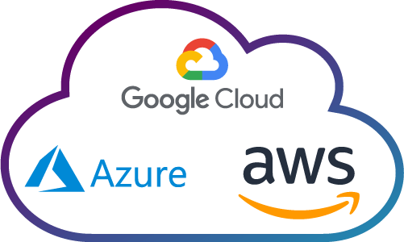
Cloud computing
Amazon AWS
Google Cloud
Microsoft Azure

Slide 24
Agenda
Introduction of Python Framework
Data Science Visualisation Tools
Demonstration of Integration of python Flask Framework and machine learning
Summary
https://towardsdatascience.com/data-visualization-with-bokeh-in-python-part-iii-a-complete-dashboard-dc6a86aa6e23

Slide 25
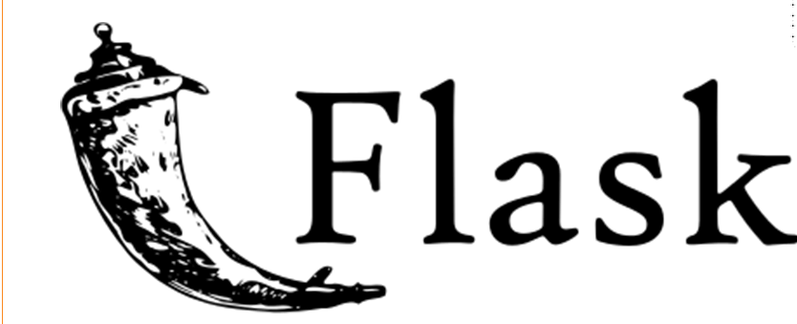
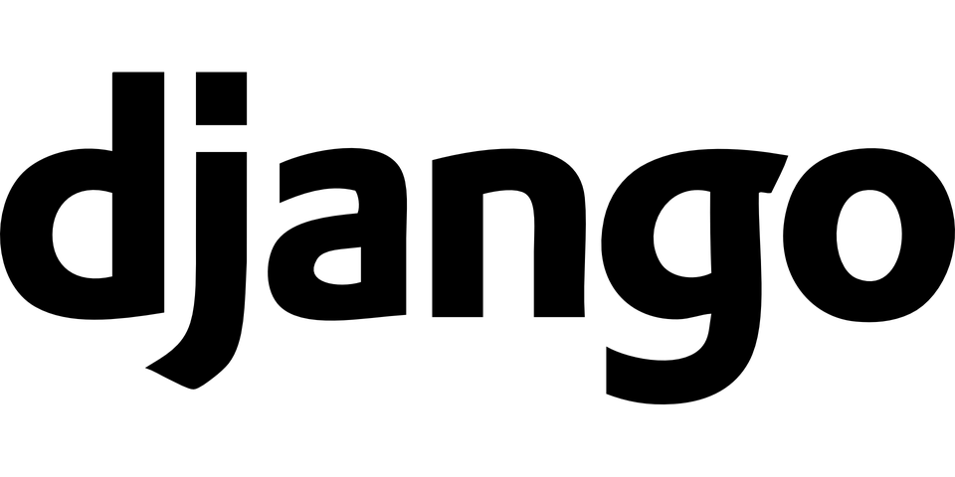
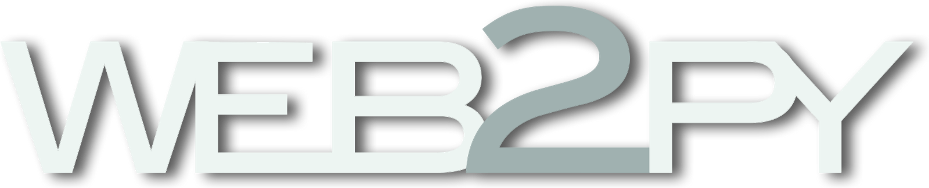
Introduction of Python Framework
Flask - Flask is a microframework for Python. The main purpose is to develop a strong web application base. As compared to Django, Flask is best suited for small and easy projects.
Django - Django is a high-level Python Web application development framework that encourages us to develop things rapidly. It’s free and open source.
Web2Py - It is a free open source full-stack development framework in python which allows the user to develop things quickly. It is a cross-platform framework that supports all popular operating systems.

Slide 26
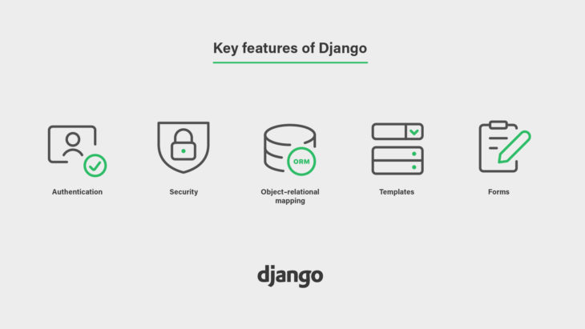
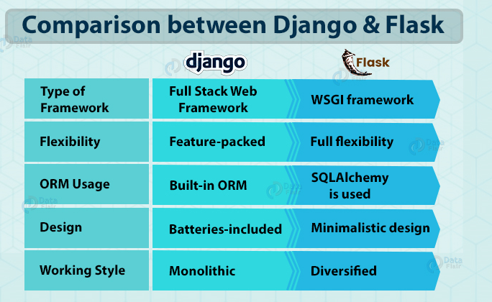
Commonly used Flash Framework

Slide 27
What is Dash / Python Flask Framework?
Dash is Python framework for building web applications. It is open source, and its app run on the web browser
It built on top of Flask, Plotly.js, React and React Js.
It enables you to build dashboards using pure Python.

Slide 28
What is Dash / Python Flask Framework?
Every Dash App is composed of two main parts:
Layout = is used to define how all the content should be laid out on the application.
Callbacks = are used to make each of the desired components of the Dashboard interactive.

Slide 29
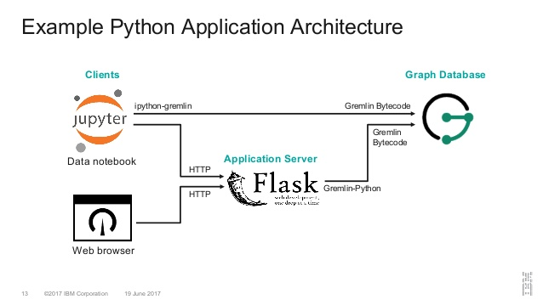
Python Flask Framework Architecture

Slide 30
Installation of Python Flask Framework
Step 1 : Install virtual environment
Step 2 : Create an environment
Step 3 : Install Flask
Step 4 : Create a application
https://dev.to/sahilrajput/install-flask-and-create-your-first-web-application-2dba

Slide 31
Creating an online Data Science Dashboard
A good Dashboard can：
Summarise the main results of a data analysis.
Enable the customers/company managers to test how varying some parameters can affect a certain outcome.
Fetch continuously new data to update its graphs and summaries.
Allow us to make predictions online using either pre-trained Machine Learning models or training them online.

Slide 32
Data Science Visualisation Tools
Dash by Plotly (Python programming knowledge) - https://plot.ly/dash/
Bokeh Dashboards (Python programming knowledge) - https://bokeh.org/
D3.js (Python programming knowledge) - https://d3js.org/
Google Data Studio (necessarily require any programming knowledge) - https://datastudio.google.com/
Tableau (necessarily require any programming knowledge) - https://www.tableau.com/
More examples : https://towardsdatascience.com/interactive-data-visualization-167ae26016e8

Slide 33
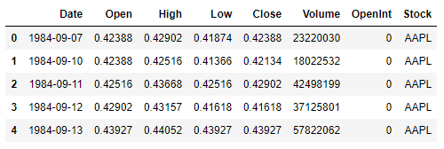
Procedure of the integration of ML and flask
Step 1 : Create a python file
Step 2 : Import suitable library (dash, pandas, plotly)
Step 3 : Collect Data Source in CSV format
Step 4 : Setup the app using flask framework

Slide 34
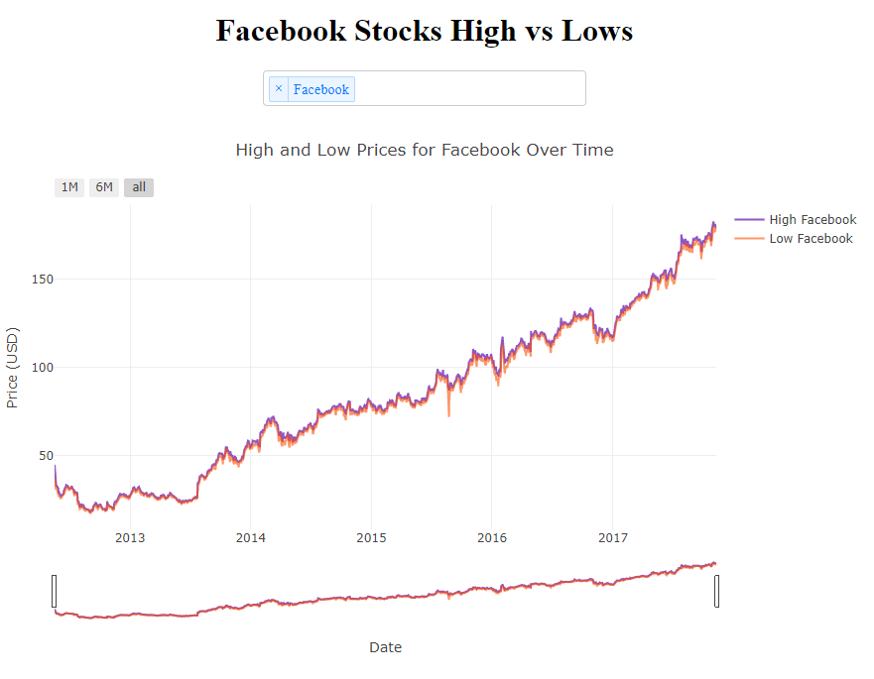
Procedure of the integration of ML and flask
Step 5 : Conduct the layout using HTML library
Step 6 : Conduct callback to show the value from the source
Step 7 : Conduct Data Visualization
Step 8 : Start Web Server for python file
Step 9 : Dash Apps Deployment on Heroku

Slide 35
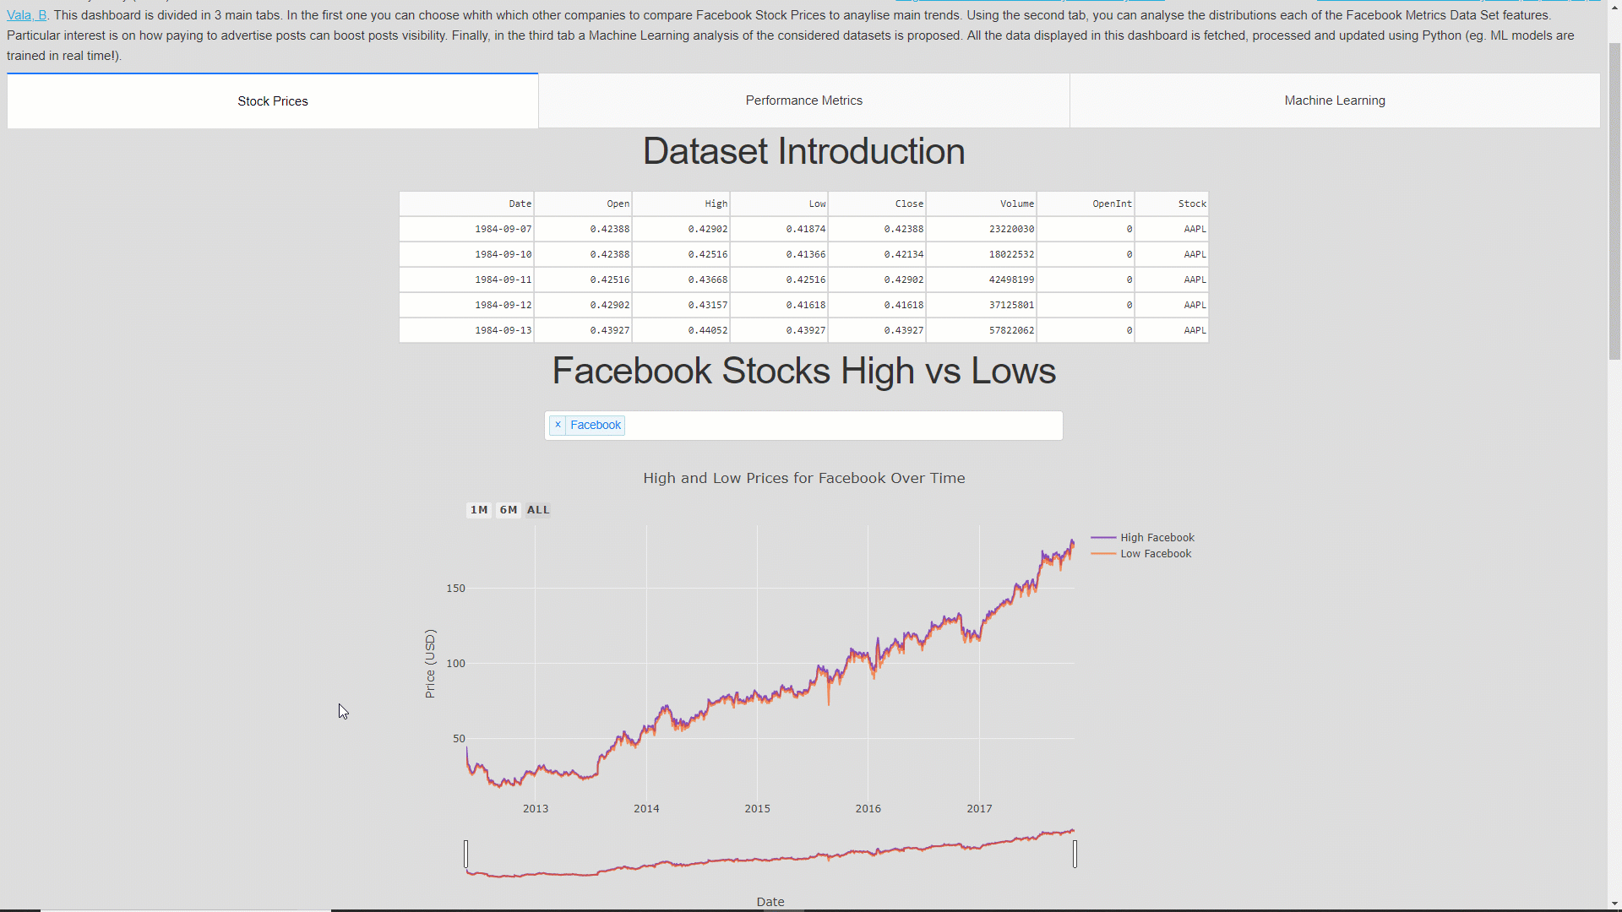
Demonstration of Integration of python Flask Framework and machine learning

Slide 36
Summary
This Dashboard can be further developed by adding additional features such as:
Use a web-scraping mechanism to fetch new Stock Market data in real-time to update all the related graphs.
Add more Data Visualisation charts.
Create Machine Learning models to make predictions (eg. ARIMA， LSTM).
Improve the Dashboard overall design

